Slide 1
Customer Segmenatation Dashboard_v2024.2
File created on: 2025-04-20 10:40:25 PM

Slide 2
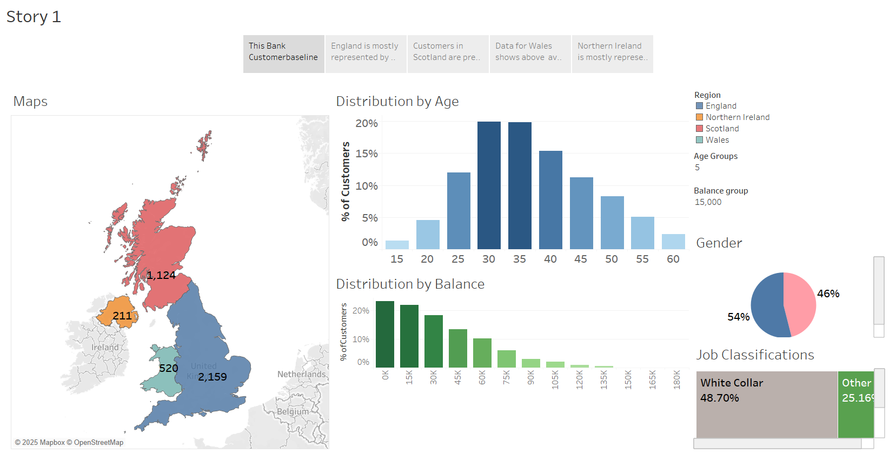

Slide 3
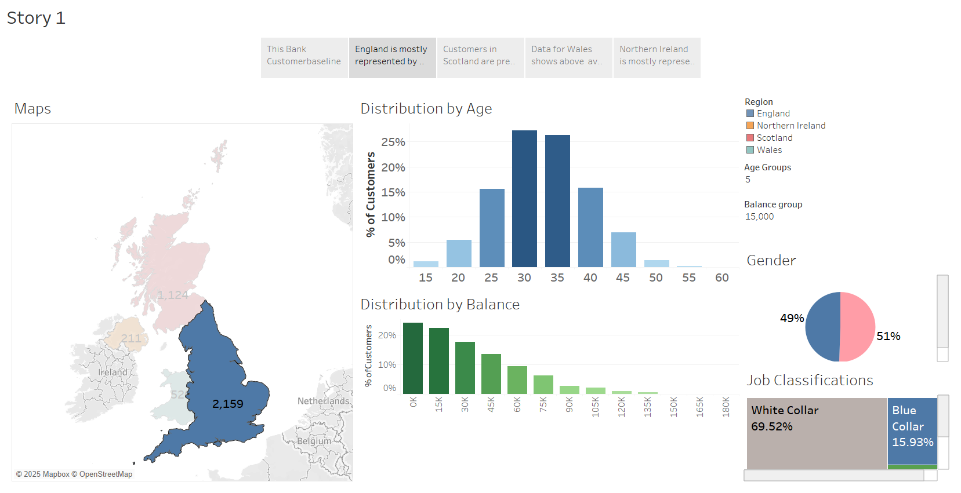

Slide 4
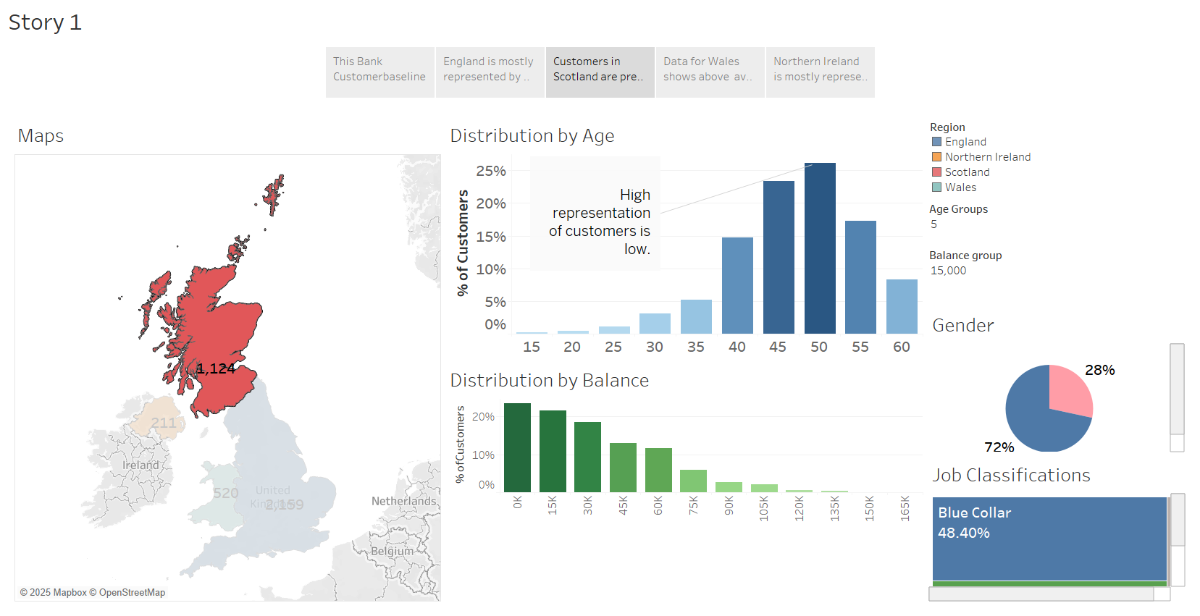

Slide 5
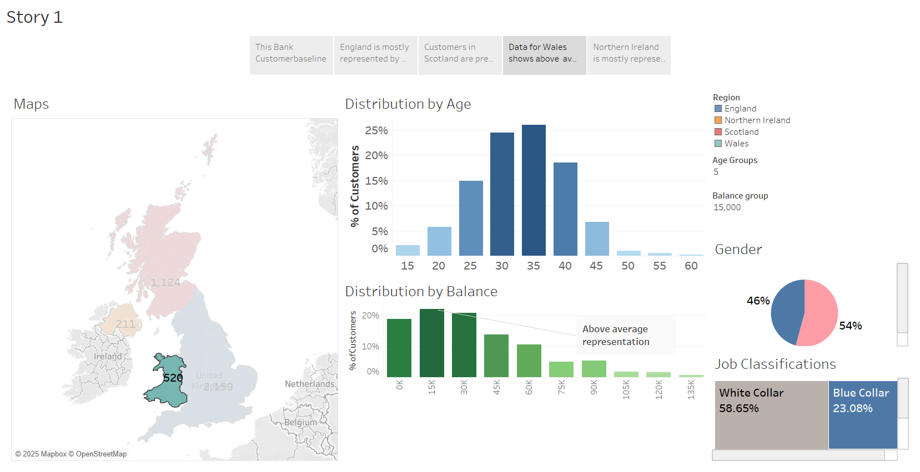

Slide 6
